Slide 1
Specifications for the Pilot Production of Berat Extra Virgin Olive Oil
Ambassador of Berat – 2025 Edition

Slide 2
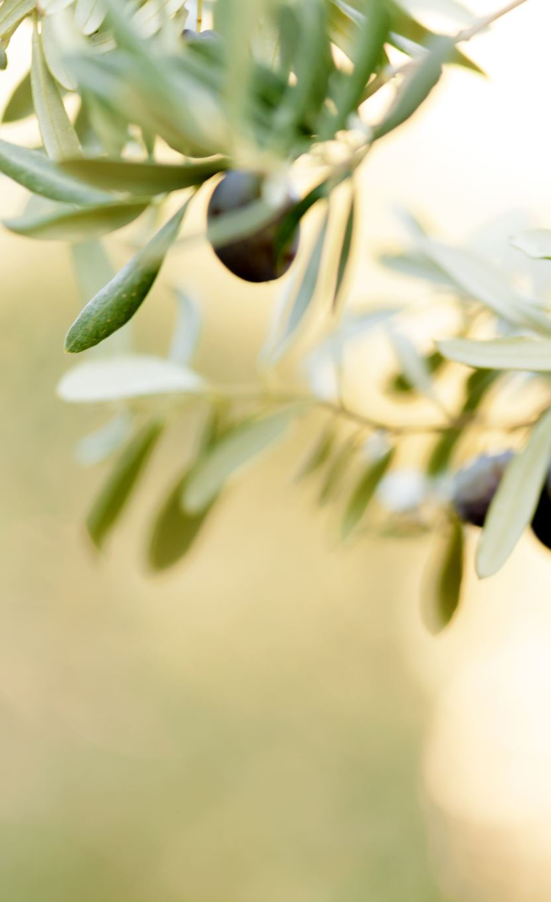
This document defines the minimum essential criteria for the experimental production of “Ambassador of Berat,” with the goal of ensuring excellence, consistency, and authenticity.
The pilot production will involve four cultivars:
Grande di Berat
Leccino
Frantoio
Velagosht
Main Specifications
The millers participating in the pilot commit to the following:
Harvesting and pressing must occur on the same day; if not possible, olives may be stored overnight at the mill, in bins filled to a maximum of 70%.
Equipment hygiene is mandatory: crushers, malaxers, filters, and all processing components must be free from previous residues and well-ventilated to avoid contamination and off-flavors.
The experimental batch will consist of 50 liters (5 quintals) for each cultivar, preceded by a “start-up” cleaning batch of approximately 1 quintal.
Malaxation temperature must remain at ambient levels, with malaxation times between 5 and 20 minutes.
The processing line must include an appropriate filtering system, including a Barese-type filter if required.
A dedicated storage tank of maximum 50 liters capacity must be ensured for each batch.

